Slide 1
Capstone Project 2 An ML model for Third Party Data Enrichment
Julia Hu

Slide 2






Understanding the Customer
Fast Data
How Technology is Consumed
Customer Context Management
Digital Customer Profile
Complex Event Processing
Cognitive Reasoning/ Prescriptive Analytics
Stream Integration
Big Data Quality
Information of Everything
We are here
Customer Information Management
Governance
Knowledge Graphs
Self-service
Embedded Predictions
Natural Language Processing
Data Federation
Real-Time, Operational
Data-as-a- Service
Customer Data Quality
Cleansing/Matching
Profiling & Segmentation
Extract Transform Load (ETL)
Data Mining
Batch, Consolidated, Analytical
List Processing
Postal Compliance
Listing Processing (De-dupe, Name Stand.)
Global Addressing
Batch, Output
Data at Rest
Evolution of Industry Technologies
Physical
Digital (Web)
Digital (Mobile)
Broader Digitization
(People, Machines, Things, Logistics)

Slide 3





Customer Data Architecture
Third Party Data Enrichment
Operator Dim: Build Understandings for potential customers
Internal Customer Enrichment
Safegraph
Yelp
Internal Ship-to Customer Data Decuplication
Single View of Customer (SVOC)
Chainstore
Hotel Group
Healthcare Group

Slide 4




Key Improvement of the New ML algorithm Customer Data Matching
Smart Use of Computing Resources
Elastic Search Algorithm and Library Performance Validation
Elastic Search Al
Seamlessly integrated with AWS services
Modular Code Structure, and Resilient Code Performance with Rigorous QA
Notes:
1. Main algorithm is running on a EC2 instance, instead of using a Windows server. This EC2 can be spin up and shut down with demand.

Slide 5
Highlights of ML model:
1. Two Stage Cascade Model: The first stage is matching blocked records with same zip code and address number. The ML on these records have a more relaxed division point threshold for tree based models. (XGBoost)
2. Second Stage are for all records having the same zip code. More feature engineering for this stage.
3. One development for feature engineering: Break down Record Linkage library, and fine tune parameters from Record linkage to generate more accurate similarity comparisons for “String” type features(NLP language), and “Numerics” features.

Slide 6
Reason for developing our own ML algorithm Instead of Using FindMatches
Delta updates will only perform on the newly updated records, instead of running all deduplication software from the start.
It will also keep the same cluster ID, the unique identification code for syscoID, easy for tracking history, and served as a golden records.
The match needs to be updated on a weekly basis, and requires high level of flexibility. There are customized data-cleansing changes required for each third party data.
The ML approach we proposed is cost-effective.

Slide 7
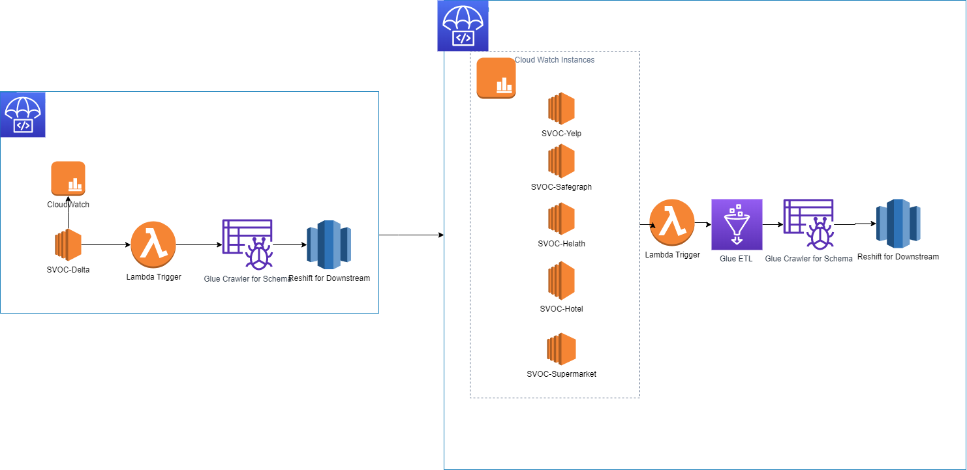
SVOC DAAS Model

Slide 8
Elastic Matching Algorithm Diagram for DELTA Update
Feature Engineering
Record Linkage to match new records to existing clusters
SYSCO data with “DELTA” flag
Data Cleansing
Matched
City,
Unmatched
State,
Address,
Record Linkage to create new clusters for all unmatched data (both old and new records)
Final CSV Output
Zip,
Customer Name
Both Match and Dedup algorithms in the Delta process use Expectation Maximization Method (a more advanced type of K-Means)
Clustered SYSCO data
Data Cleansing
Feature Engineering
Notes:
CHD data needs to be matched after each LAMBDA process

Slide 9
Diagram for Third Party Matching Software
CHD
Data Cleansing
Redshift
Record Linkage to Calculate Record Similarity Score
Expectation/Conditional Maximization algorithm for Matching
SYSCO
SQL server
Data Cleansing
Final CSV Output

Slide 10
Challenge 1 in this Third Party data match model
Record Linkage Library ML model is unsupervised. It is important to transform the unsupervised DS model into Supervised DS model for higher accuracy

Slide 11
Summary of the Current Unsupervised Algorithm
Redshift
Current Unsupervised Algorithm is good for providing fast initial result
However, there is a major pitfall for this method: Lack of Rigoristic Measurement for Accuracy.
Because Unsupervised learning does not have labeled targets
This create obstacles for further algorithm optimization (No way to compare effectiveness of algorithms)
Initial study showed that machine learning is not one size for all: optimum thresholds are different for different states (e.g. NY and LV need higher thresholds, because many shops sharing same address in one plaza)
SQL server

Slide 12
Proposed Machine Learning Optimization for SVOC and CHD
Data labelling on matched CHD results from current Python code for two states: CA and TX
Identify origin of errors from labeled data and develop Machine Learning optimization Accordingly

Slide 13
Initial Ideas for Machine Learning Optimization
Extensive Feature Engineering: Use Advanced Data Cleansing on Address, e.g. create a detailed address number for customers within Plaza
Compare “Bill to” name similarities for multiple restaurant within a large hotel, resort and casinos. (We plan to use “Bill to” information to help “Ship to”, and we do not require any “Bill to” deduplication process. Remember this is just one extra feature we engineered)
Create advanced filter for data-cleansing: e.g. remove ”ship to” records with customer name containing “Bill to Only”
Use CHD “cuisine types” and “market segment type” for machine learning

Slide 14
How to measure CHD and SVOC Machine Learning?
ROC
Accuracy Of labeled data
This is why Data Labeling is important at this stage: An objective measure for Machine Learning

Slide 15
Several Examples for Unsupervised Learning Pitfall
Multiple customers within one hotel/casino: same address.
Although they are within one hotel, but they may have different owners.

Slide 16
Several Examples for Unsupervised Learning Pitfall
Multiple customers at one location with similar customer names:
Very Interesting examples, CHD records at the same address have three different restaurant name. Both Shogun and Jiro are Japanese restaurants. The extra features (cuisine types and market segments) from CHD data can improve differentiating such records.

Slide 17
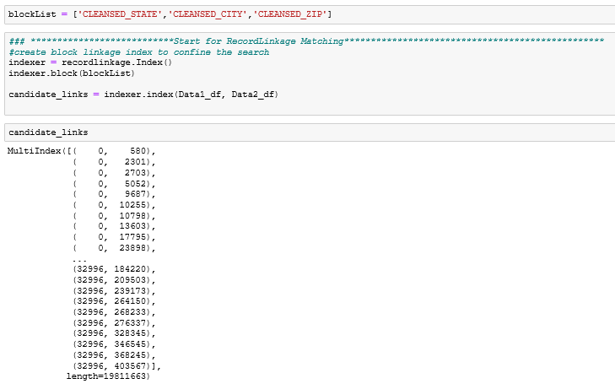
How to Break-Down Record-Linkage for ML
(1) Use Record Linkage to generate index-pairs between Safegraph and Sysco (This is a very efficient way for finding possible matches):
Notes:
The threshold to generate possible matches were a lot lower than algorithm we used for delivery. This is to purposefully generate many more False Negative, so the machine can learn from many different cases, and find the correct patterns from these examples.

Slide 18
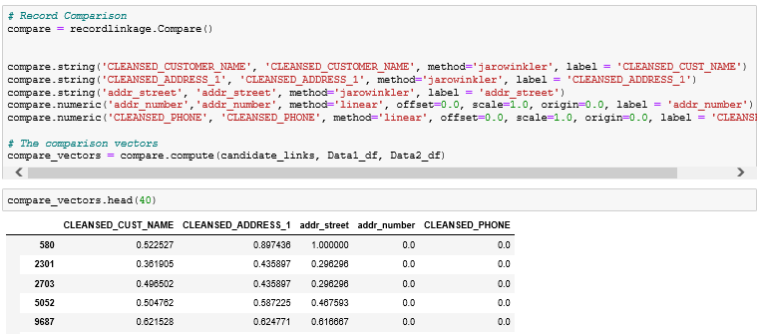
How to Break-Down Record-Linkage for ML
(2) Use Record Linkage to calculate String/Numeric Similarity scores within blocked indices between two databases:
Notes:
The threshold to generate possible matches were a lot lower than algorithm we used for delivery. This is to purposefully generate many more False Negative, so the machine can learn from many different cases, and find the correct patterns from these examples.

Slide 19
Functionality of Record Linkage Library
Index Pairs | State | City | Zip | Address Name | Address Number
(Record 1, Record 2) | 1 | 1 | 1 | 0.9 | 1
(Record 1, Record 3) | 1 | 1 | 1 | 0.8 | 0.4
(Record 2, Record 3) | 1 | 1 | 1 | 0.85 | 0.4
Total number of index pairs needs to be calculated from all 51 states: 53,541,044, and top 10 states are counted for 60% of the index pairs: 29,561,880
To reduce the amount of computation, we confine the comparison for records with the same State and City.
After String similarities are calculated, unsupervised classification is performed to cluster results accordingly.

Slide 20
Initial Quality Check for CHD Data Matching
Scenario | Descriptions | Match | Error Code
1 | different stores within a shopping center/village | FALSE | 1
4 | Multiple stores/hospitals/supermarkets within a plaza | FALSE | 1
6 | Different hotels/schools with the same address | TRUE/FALSE | 1
11 | Different stores with the same address but different suite numbers | FALSE | 1
19 | Different departments within a supermarket/hotel | TRUE
24 | Different stores within a University | TRUE
29 | Different stores within a food court | FALSE | 1
30 | Different college housing under the same address | FALSE | 1
31 | Different clubs within a school | FALSE | 1
0 | Others
15 | Different in addresses | FALSE | 2
2 | Sysco record is entire hotel/resort/casino, but CHD records is a store/conference room/dining room/bar within the hotel | TRUE
9 | Sysco record is the entire school/club/church/office. CHD record is a store/stadium/garden/department/café..etc. | TRUE
14 | Sysco record is a hospital/nursing center, but CHD’s record is a store in the hospital | TRUE
17 | Sysco record is the entire shopping center/historic district, but CHD record is a store within the shopping center | TRUE
26 | Sysco record is a supermarket, and CHD record is a department of the supermarket | TRUE
 |  | TRUE
3 | CHD records is the entire club, but Sysco record is an event center/food department/kitchen within a club
12 | CHD record is the entire hotel/casino, but Sysco’s record is a store/kitchen/catering/banquet within the hotel | TRUE
16 | CHD record is the entire school/salvation army/nursing home/farm/club, but Sysco record is a store/central kitchen/department/catering/cafeteria/band within the school | TRUE
21 | CHD record is a detention center, but Sysco record is a food store | TRUE
22 | CHD record is a supermarket, and Sysco record is a department of the supermarket | TRUE
20 | CHD record is the entire village, but Sysco record is a store within a village/shopping center | TRUE
5 | Sysco record is a restaurant or a store, but CHD record is the company that owns the restaurant brand. | TRUE
25 | CHD record is a restaurant/healthcare center, and Sysco record is the company that owns the restaurant/healthcare center | TRUE
28 | CHD record is a restaurant or the company, and Sysco record is the billing account | TRUE
8 | Restaurant has changed the owner, and CHD has the current owner record | FALSE | 3
10 | Restaurant/hospital has changed the owner, and Sysco has the current owner record | FALSE | 3
23 | Sysco record is district, and CHD record is the school | TRUE
13 | Sysco record is a resort/club/school, but CHD’s record is a estates/district | TRUE
27 | CHD record is a school district, and the Sysco record is the food service department | TRUE
18 | Error on CHD record | FALSE | 4
7 | CHD record’s customer name/information is probably wrong or outdated | FALSE | 4
Single View
of Customer
+ relationships
+ all interactions
Customer-Centric Insights
Products & Services Purchased
Transactional Information
Applying analytical capability to provide insight
Error-type-Coded data labeling is adopted for training data.
At the moment, data labeling is only used for accuracy validation.
We will implement supervised learning optimization with the labelled data.
Sales, Billing, Customer Center, Support, etc.
Date Integration
Data Cleansing (Data Quality)
Data Supplementation (Reference Data)
Data Enrichment
(Geocoding)
Ownership
Single View of Customer
Organizational Relationships
Interactions Information from Social Media
Predict
Social Network
Location Relationships
Anonymous Web & Mobile Interactions
Notes:
Due to the very limited features being adopted at the moment, error type coded data labeling technique is adopted in this study to pin down if there are consistent or repetitive errors being made. If there are, further feature engineering will be adopted.

Slide 21
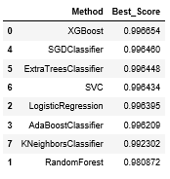
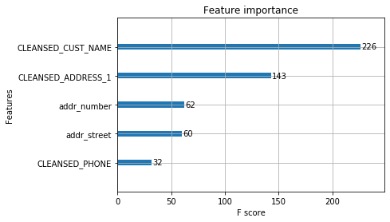
In-house Machine Learning Algorithm for Customer Data Matching
Implemented Supervised Machine Learning Model instead of Fuzzy Matching: Consistent measures of matching probability
Extensive Feature Engineering for Attributes-based matching: Comprehensive consideration of various types of evidence for matching
Use Third-party python library to generate index-pairs between Internal and External data: Solved the memory and computation efforts of Fuzzy Match
In house software that can be run economically on a serverless virtual machine: AWS FindMatches is expensive and use the similar algorithm
Fig. 1: Comparison of ROC scores of different ML model
Fig. 2: Attributes used for ML algorithm

Slide 22
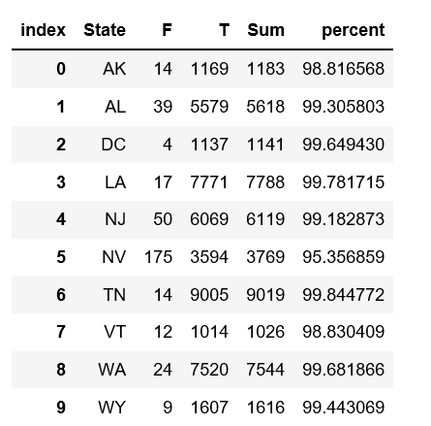
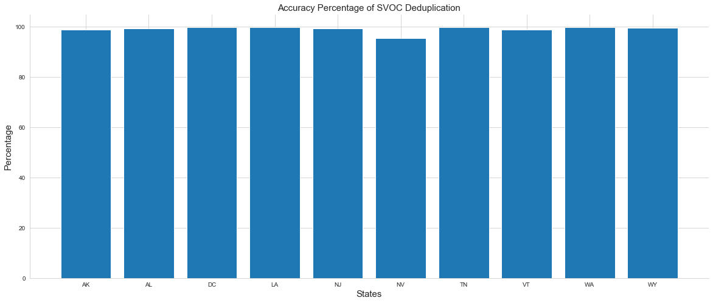
Accuracy Validation for SVOC Deduplication Software

Slide 23
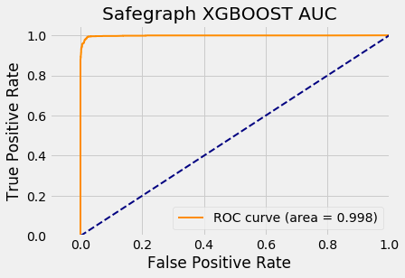
Apply XGBoost model to Test Data Prediction
High accuracy without overfitting problem
Notes:
It is a lot more expensive than a EC2 instance: By default, AWS Glue allocates 5 DPUs to each development endpoint. You are billed $0.44 per DPU-Hour in increments of 1 second, rounded up to the nearest second, with a 10-minute minimum duration for each provisioned development endpoint.

Slide 24
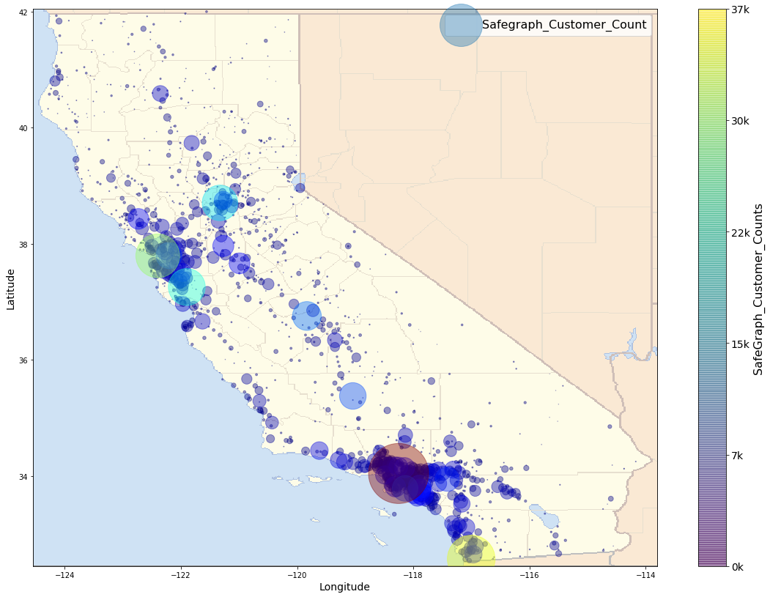
Safegraph Record Number Counts Distribution in CA

Slide 25
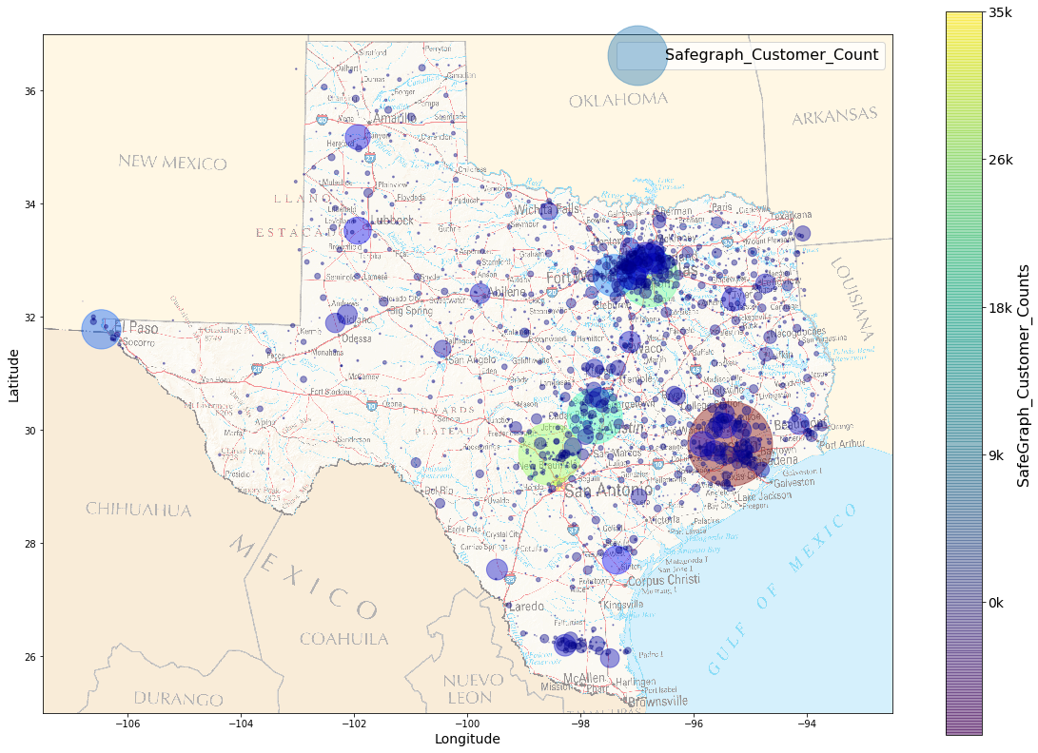
Safegraph Record Number Counts Distribution in TX

Slide 26
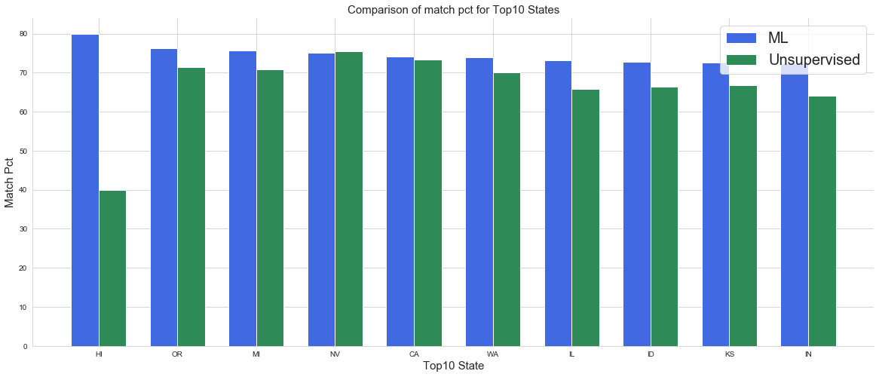
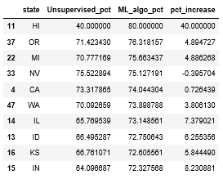
Comparison of Safegraph Match Pct for Top 10 States with Highest Count Pct

Slide 27
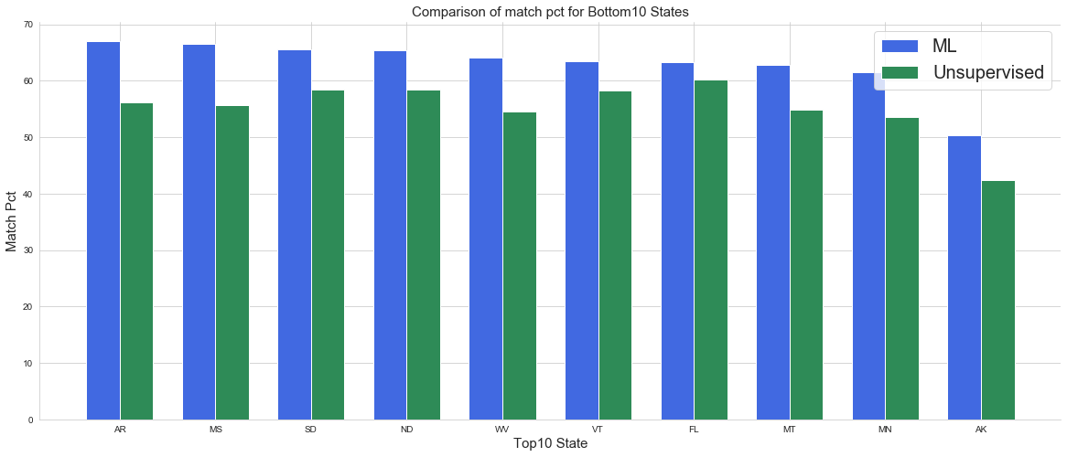
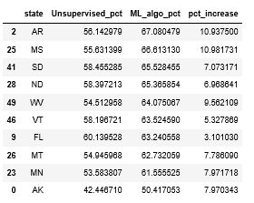
Comparison of Safegraph Match Pct for Bottom 10 States with Lowest Count Pct

Slide 28
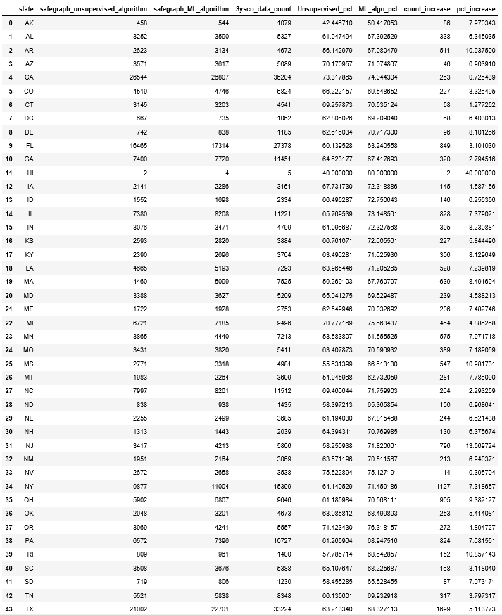
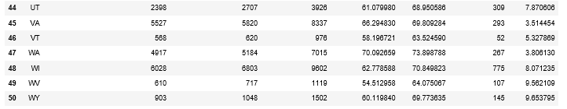
Safegraph Match Pct for all 51 States

Slide 29
Comparison of SVOC-Third Party Data Match Count for ML and Unsupervised Algorithm
 | ML Algorithm | Old Algorithm | Difference
Total Matched Count | 242011 | 223747 | 18264
Total Count Pct for Sysco Data | 70% | 64% | 6%

Slide 30
Summary
Initial validation on Base Model is promising, However more ML Optimization can be implemented for future external database matching
Current model is running on a EC2 machine, the data is sliced by States. There are possibility for further IPyParallel implementation.
Continuous data quality check once the two software are deployed for production

Slide 31
Challenge 2 in this Third Party data match model
Number of records need to be calculated for similarity comparison is significant. This imposes challenge for computational resources

Slide 32
Comparison of Different Dataset Sizes
 | CHD | Internal
No. of Records | 1,910,120 | 307,574
Ratio Comparison | 6.3 | 1
CHD is a much bigger dataset
Other external datasets can be a lot bigger than CHD

Slide 33
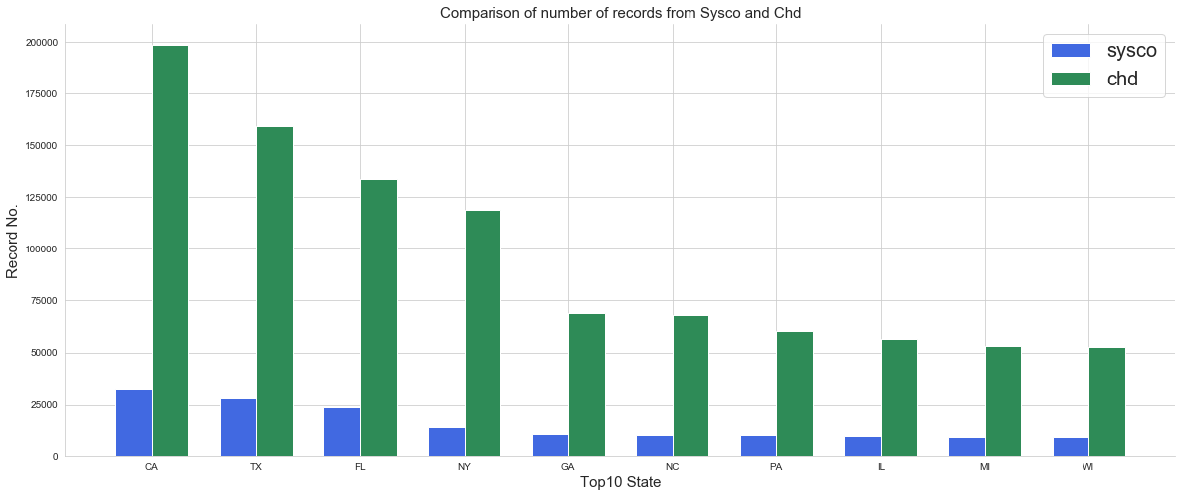
Side by Side Comparison

Slide 34
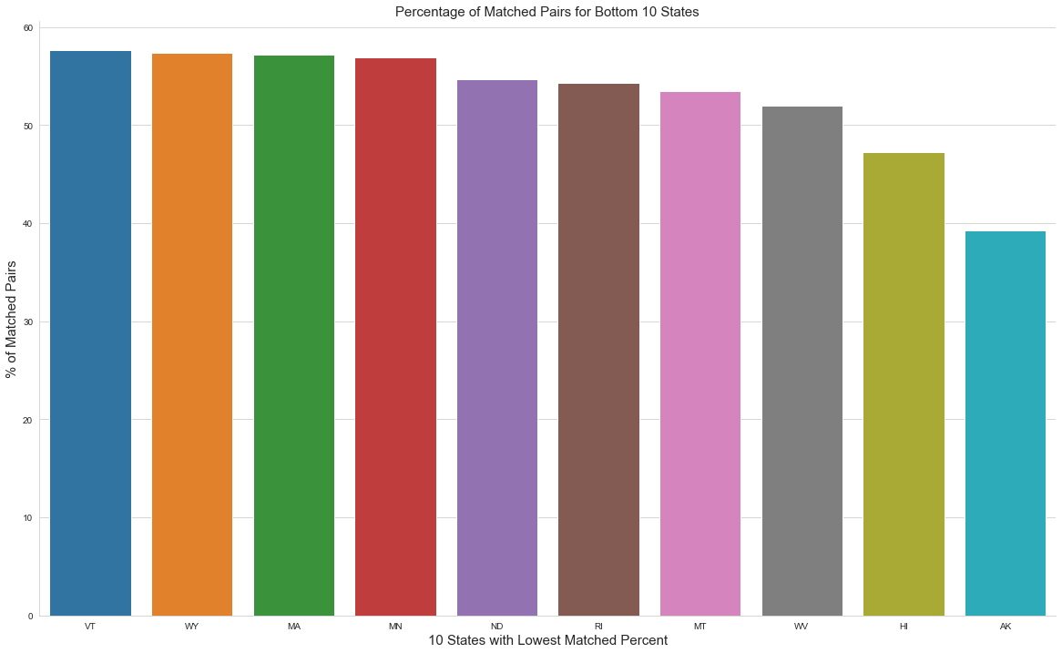
CHD-SYSCO Matching Percentage Check
On average, the matched percentage for Sysco customers with CHD is 62%
Bottom ten states have match rates bigger than 50%, except AK

Slide 35
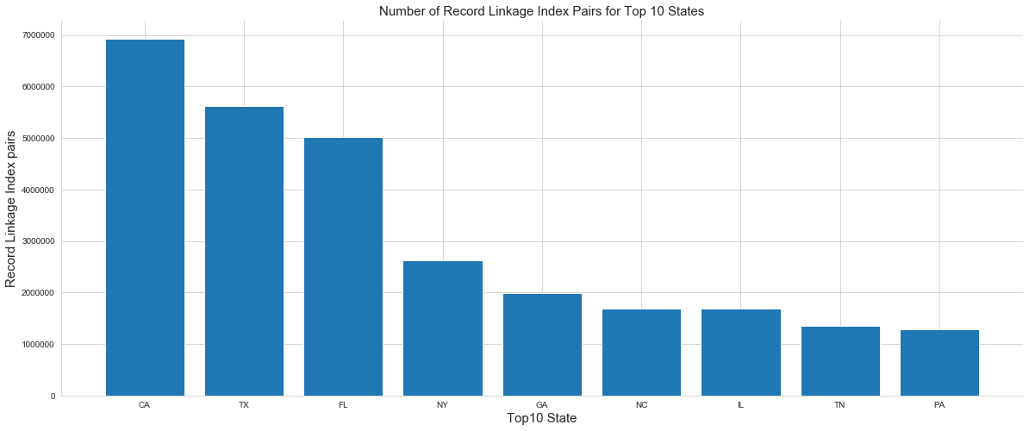
Total Number of Index Pairs generated from RecordLinkage for Calculation
Total number of index pairs needs to be calculated from all 51 states: 53,541,044, and top 10 states are counted for 60% of the index pairs: 29,561,880

Slide 36
Next Step: Get Ready for Production
Develop a suitable cloud based workflow that can scale the ML model easily.

Slide 37



Proposed Architecture
1
4
5
8
SDR : SVOC_CUSTOMER_DATA_UNION_STG
SEED : FP/USBL/SSMG/Any other BU
2
4.Internal matching results in csv**
1.Logically Active Customer Extraction cleansing ( Informatica)
5.ETL process to load matched clustered data
3
7
3.Invoke data pipeline to spin up EC2 instance for SVOC MainMatching algo.
7.Matching results in csv**
SDR :SVOC_CUSTOMER_DATA_UNION_MASTER
2.Delta Processing
--New Customer
--Logically Inactive
--Change in Name and Address
6
6.Invoke data pipeline to spin up EC2 instance for SVOC matching with external sources/non Sysco
SEED : CHD/YELP
8
8.Load internal and external matched data into SEED

Slide 38
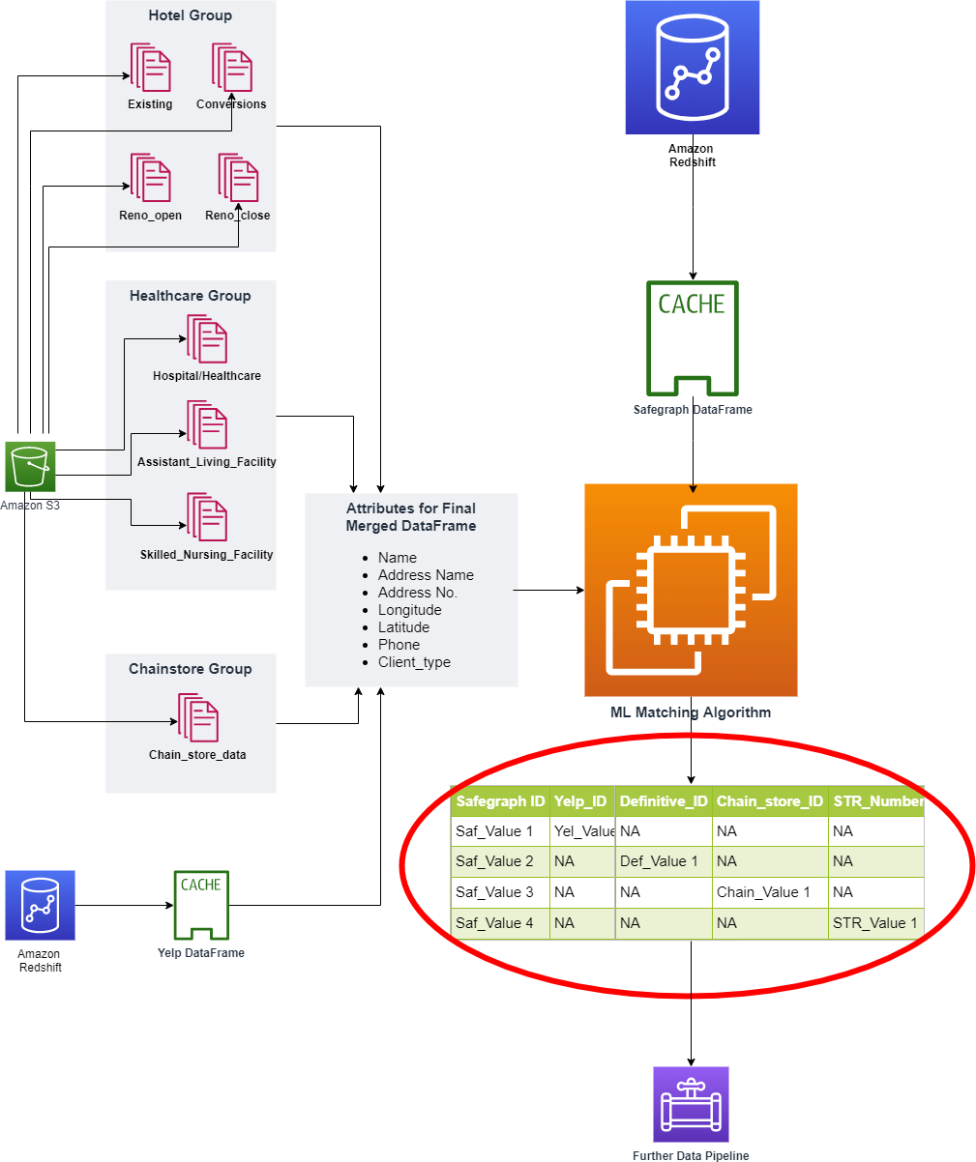
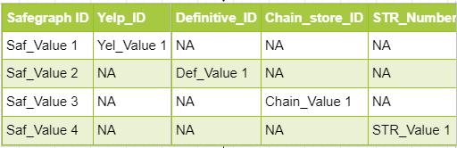
Software Architecture for Third Party Operator Dim
Highlight of the Proposed Architecture:
Concat all four different types of operators into one dataset. This operation is based on the mutual independent characteristic of these operator types.
Extract common features from both the concatenated dataset and Safegraph data for machine learning. These features are: (1)Customer name, (2) address name, (3) address number, (4) longitude, (5) latitude, (6) phone, (7) customer category.
Output a final table where each safegraph ID is matched with one unique record from the concatenated dataset. The output table key structure is like this (Such key structure is designed for easy linking different types of operators):

Slide 39




AWS Glue will be the workhorse for SVOC data-pipeline
AWS Glue will play a major role in creating ETL job after the ML algorithm, fast Data Catalog, and schema refinement.
Why AWS Glue:
Fast Data Catalog especially suitable for ad-hoc table creation and big query: Glue Grawler has classifer logic to infer the schema, format and datatype.
Further ETL job is authored to refine table structure by using the metadata generated from Cralwer, e.g. columns structures, datatypes. ETL jobs are flexible to process multiple third-party data, table add-on or remove.
Data stay in Sync with ML in a cost-effective way
Notes:
Reasons for using AWS Glue: Populates the AWS Glue Data Catalog with table definitions from scheduled crawler programs. Crawlers call classifier logic to infer the schema, format, and data types of your data. This metadata is stored as tables in the AWS Glue Data Catalog and used in the authoring process of your ETL jobs. Detects schema changes and adapts based on your preferences.

Slide 40

Utilizing CloudWatch to maximize economic benefit
On top of AWS Glue, our architect will use AWS Cloudwatch as major event triggers (Glue job schedule, monitor job logs and retries) and monitoring tool.
Cost Analysis with GloudWatch: Gathers runtime metrics to monitor and optimize the Glue job cost.
Notes:
It is a lot more expensive than a EC2 instance: By default, AWS Glue allocates 5 DPUs to each development endpoint. You are billed $0.44 per DPU-Hour in increments of 1 second, rounded up to the nearest second, with a 10-minute minimum duration for each provisioned development endpoint.

Slide 41
Summary
Algorithm Analysis Performed respectively on Python and R version of RecordLinkage
Initial research was performed to implement the RecordLinkage on Spark platform: Strategic move for future external data consumption
To improve the performance, apply supervised learning algorithm

Slide 42
Future Work Plan
1. Python Solution:
(1) Further Software Engineering
(2) Cloudwatch +EC2
(1)PythonConda on Zeppeline
(2)Infrastructure (no. clusters Vs cost)
(3) Software Engineering
2. PySpark Solution:

Slide 43
Other Improvement details and Future Plan
Other improvements: (1) ML algorithm provides more accurate probability statistics for matching pairs, and therefore only the record with highest probability is chosen. This effectively solved the multiple similar/repetitive third party records matching to one Sysco record.
(2) Matching statistics is included, and will aid Data Steward for further check.
Future Plan: Considering the high accuracy of the ML model (99%), and the consistent matching percentage across different state (all between 60 to 70%). It is difficult to improve the matching pct by simply using a different ML algorithm. It is most likely due to data quality.
It is important to look into the unmatched records to find out possible reasons for unmatching. Very likely due to wrong address: such as “key drop” or no address at all, etc.
(2) A few key word cleansing can be implemented for customer name: ARA, SODEXO, etc.

